Slide 1
HOTELS REVIEWS ANALYSIS
Principles of Text Mining
Ahmed Mohamed | Mohit Pradeep Hinduja | Indra Sardesai
Aachen | 12 Dec 2021
School of Business and Economics
TIME Research Area

Slide 2
AGENDA
Introduction
Methodology
Results
Limitations & Future Results
Data set introduction
Ahmed Mohamed | Mohit Pradeep Hinduja | Indra Sardesai
Notes:
2

Slide 3


Introduction
Objective
Challenge
Selecting the best hotel to spend our vacation at based on text mining techniques
No ratings scale available to compare hotels
What is the most relevant approach for text analysis in this context
Ahmed Mohamed | Mohit Pradeep Hinduja | Indra Sardesai
Notes:
3

Slide 4
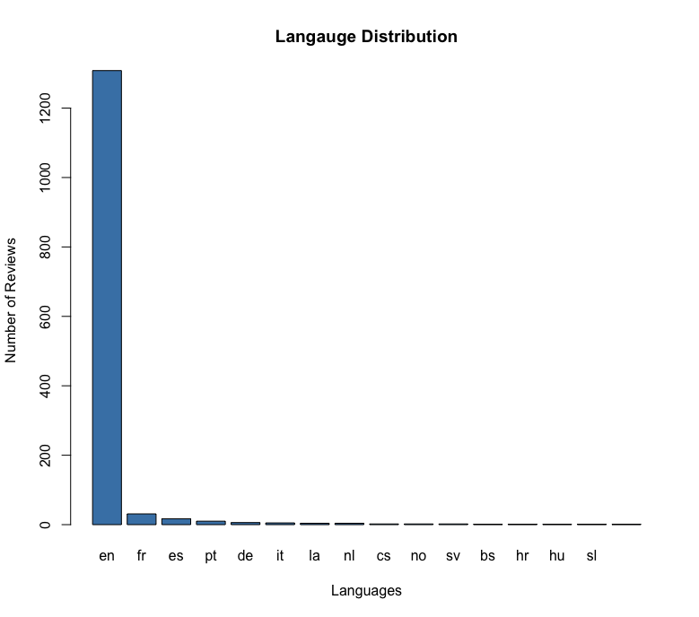
Data Set Introduction
1,400 reviews for 271 hotels in 238 cities in 97 provinces
Hotel name
Address
City
Province
Country
Review date
Review title
Review text
Username
Not all reviews are in English
16 different languages
© Chaitanya Mohite | Ahmed Mohamed
Ahmed Mohamed | Mohit Pradeep Hinduja | Indra Sardesai
Notes:
4

Slide 5



Methodology
Data Preprocessing
Sentiment Analysis – Calculate Ratings
Average Ratings & Output Analysis
Language detection & translation
Data cleaning (lowercase, numbers, punctuation, white space, stop words & lemmatization)
TF & TF-IDF approach using custom dictionary – 1st approach
nrc package, emotion lexicon having a list of English words and their associations with 8 basic emotions and 2 sentiments (positive & negative) – 2nd approach
Calculate average rating & number of reviews per hotel – 1st approach
Calculate ratio of positive to negative reviews per hotel – 2nd approach
© Chaitanya Mohite | Ahmed Mohamed
Ahmed Mohamed | Mohit Pradeep Hinduja | Indra Sardesai
Notes:
5

Slide 6
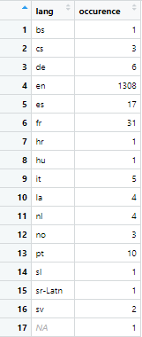
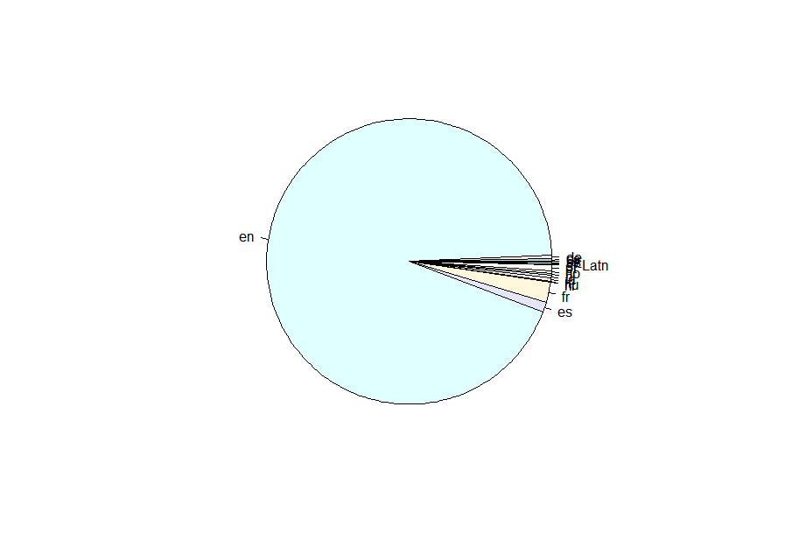
Methodology | Data Pre-processing
Language Detection
Language Translation
textcat() library to detect the language of each review
Adding a column for each review language in our data set
16 different languages were detected
93% of reviews are in English
Export original data set
Imported in google sheets
Google sheets function to translate reviews to English based on the detected language
Import the translated to English data set to our R script
© Chaitanya Mohite | Ahmed Mohamed
Ahmed Mohamed | Mohit Pradeep Hinduja | Indra Sardesai
Notes:
6

Slide 7
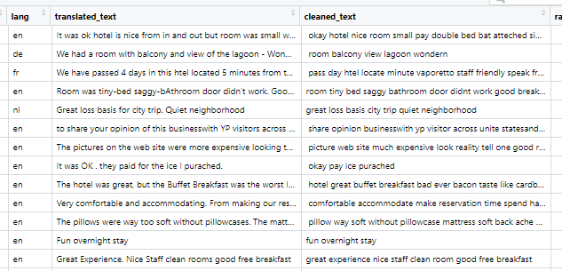
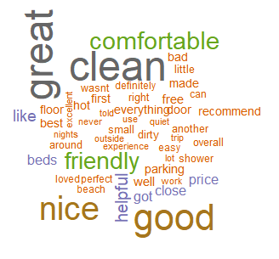
Methodology | Data Pre-processing
Language Cleaning
2 Libraries are used for text cleaning – tm() and textstem() and applied on the reviews text
Set text to lowercase
Remove numbers
Remove punctuation
Delete whitespace
Remove stop-words
Apply lemmatization
Adding a column with the translated text to our data set
© Chaitanya Mohite | Ahmed Mohamed
Ahmed Mohamed | Mohit Pradeep Hinduja | Indra Sardesai
Notes:
7

Slide 8
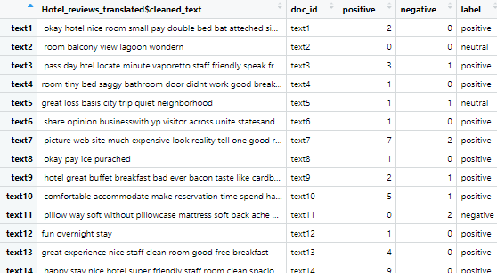
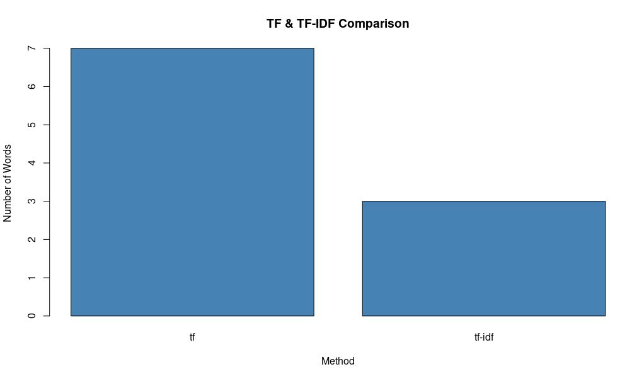
Methodology | Sentiment Analysis
1st Approach
Term Frequency (TF) & TF – Inverse Document Frequency (TF-IDF) using Custom Dictionary
Using the custom dictionary available on moodle
Creating a document feature matrix with the custom dictionary terms (positive & negative)
Creating a data frame with the review texts and the dictionary values
Assigning each review as positive/negative/neutral based on values
© Chaitanya Mohite | Ahmed Mohamed
Ahmed Mohamed | Mohit Pradeep Hinduja | Indra Sardesai
Notes:
8

Slide 9
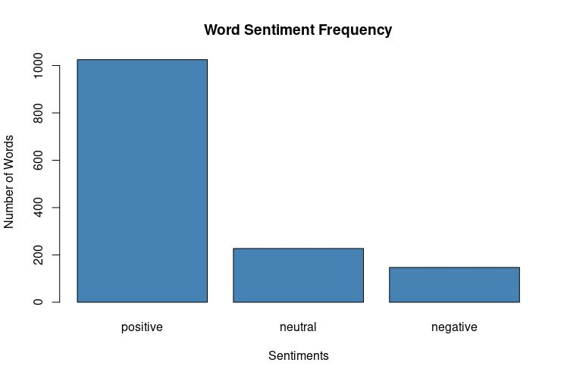
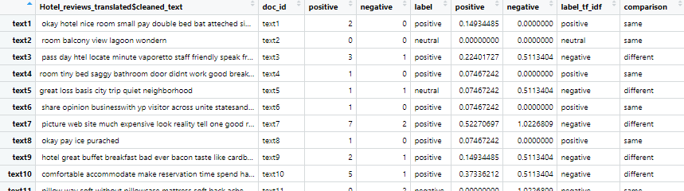
Methodology | Sentiment Analysis
1st Approach
Create the document feature matrix based on the tf-idf instead, and assign positive/negative/neutral
Create a column to compare between the tf and tf-idf results
Create a subset of the data frame with only the reviews that had different scores from both analysis
Manuel validation for the top 10 entries to decide which technique had more accurate results
© Chaitanya Mohite | Ahmed Mohamed
Ahmed Mohamed | Mohit Pradeep Hinduja | Indra Sardesai
Notes:
9

Slide 10
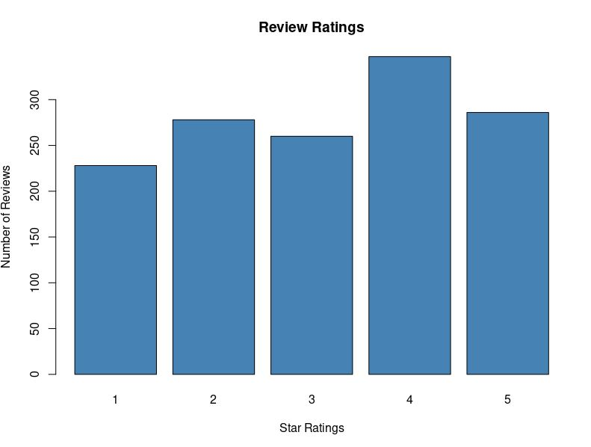
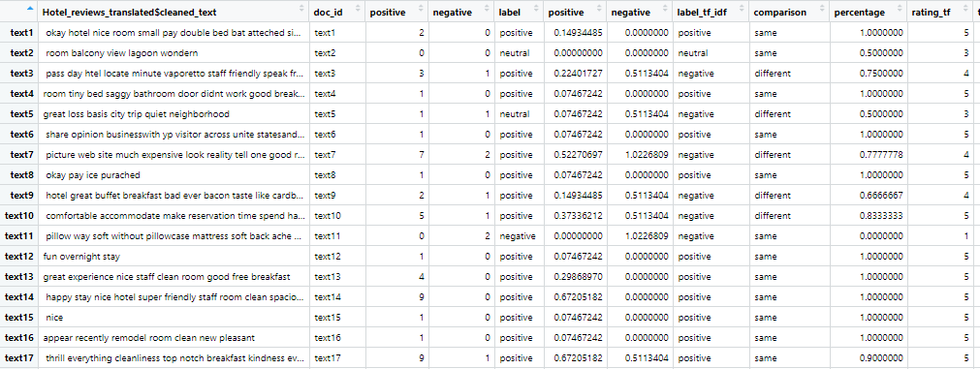
Methodology | Sentiment Analysis
1st Approach
Calculate ratings of based on the tf analysis and adding it to our translated data set
Calculate a percentage for each review depending on the count of positive & negative words
Create a scale from 1 to 5 and calculate rating based on the percentage
Most hotels are rated as 5 stars due to the custom dictionary used which was for different context
© Chaitanya Mohite | Ahmed Mohamed
Ahmed Mohamed | Mohit Pradeep Hinduja | Indra Sardesai
Notes:
10

Slide 11
Methodology | Sentiment Analysis
2nd Approach
Text Data
Analysis
Summarized
Text
Visualizations
Sentiment
Lexicon
© Chaitanya Mohite | Ahmed Mohamed
Ahmed Mohamed | Mohit Pradeep Hinduja | Indra Sardesai
Notes:
11

Slide 12
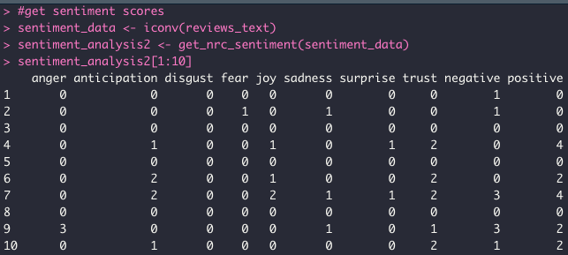








Methodology | Sentiment Analysis
2nd Approach
Tidytext and Syuzhet packages
Non-Commercial Research (NRC) Lexicon using binary association with:
Eight basic emotions - anger, fear, anticipation, trust, surprise, sadness, joy, and disgust
Two sentiments – positive, negative
Ahmed Mohamed | Mohit Pradeep Hinduja | Indra Sardesai

Slide 13
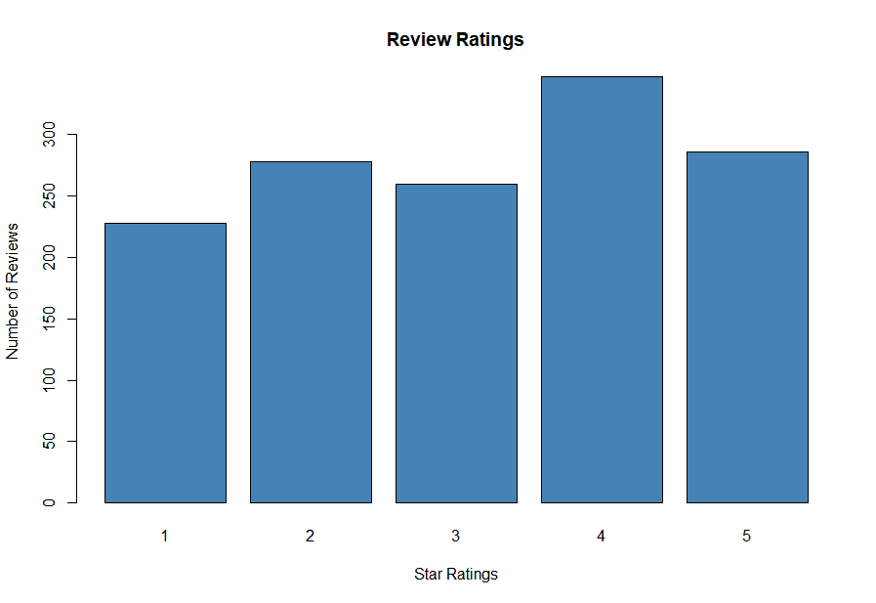
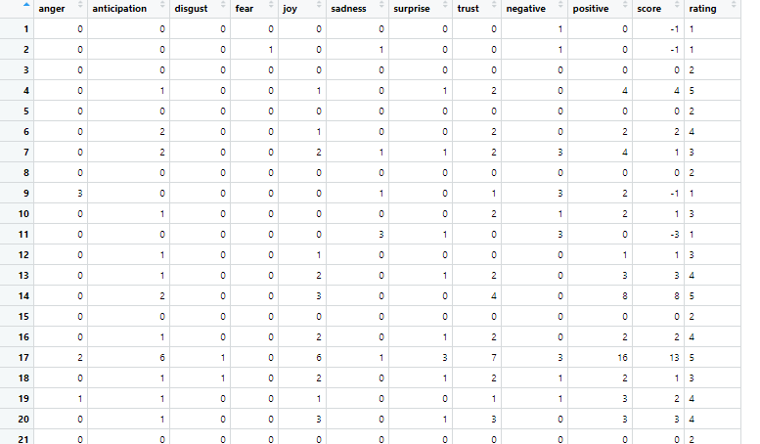
Methodology | Sentiment Analysis
2nd Approach
Using the scores calculated from the nrc sentiment analysis, we applied a rating scale from 1 to 5 using the quantile function
The function returns a rating (1 to 5) per hotel based on the score given of the sentiment analysis
Upload ratings to our hotels data set
© Chaitanya Mohite | Ahmed Mohamed
Ahmed Mohamed | Mohit Pradeep Hinduja | Indra Sardesai
Notes:
13

Slide 14
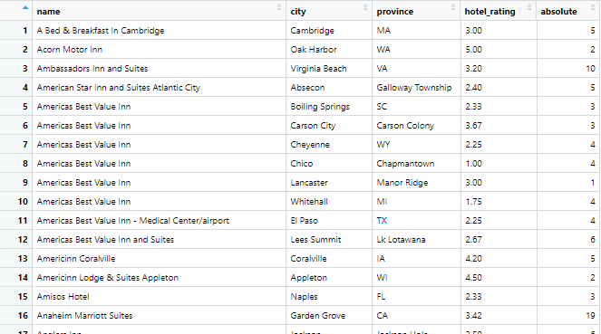
Methodology | Average Rating
1st Approach
Using ddpply function, we aggregated the data based on the hotel name in a new data frame
Calculate the average rating per hotel and the total no. of reviews per hotel
© Chaitanya Mohite | Ahmed Mohamed
Ahmed Mohamed | Mohit Pradeep Hinduja | Indra Sardesai
Notes:
14

Slide 15
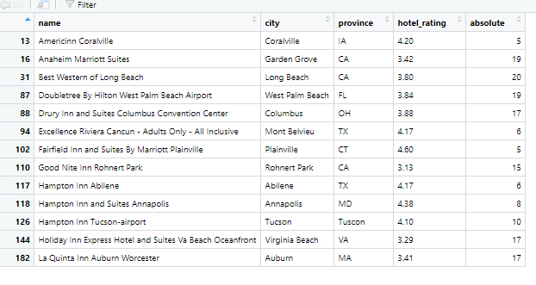
Methodology | Average Rating
1st Approach
Filtering hotels with less than 5 reviews
Using the average ratings data frame created, we created another subset of data having either above 4 average rating Or above 3 stars rating & more than 15 reviews
© Chaitanya Mohite | Ahmed Mohamed
Ahmed Mohamed | Mohit Pradeep Hinduja | Indra Sardesai
Notes:
15

Slide 16
Methodology | Average Rating
2nd Approach
Creating a data frame which includes Hotel name and review rating
Calculated No. of 4 star rating & 5 star rating of each hotel and termed as Positive reviews for a respective hotel
Calculated No. of 1 star rating & 2 star rating of each hotel and termed as Negative reviews for a respective hotel.
In a separate data frame containing Hotel name, Positive reviews and Negative reviews :-No. of Positive reviews are subtracted from No. of Negative reviews.
Based on the result of the subtraction of Positive reviews and Negative reviews recommend lists of hotel is made.
© Chaitanya Mohite | Ahmed Mohamed
Ahmed Mohamed | Mohit Pradeep Hinduja | Indra Sardesai
Notes:
16

Slide 17
Methodology | Average Rating
2nd Approach
Sorting the table according to the recommendation score
© Chaitanya Mohite | Ahmed Mohamed
Ahmed Mohamed | Mohit Pradeep Hinduja | Indra Sardesai
Notes:
17

Slide 18
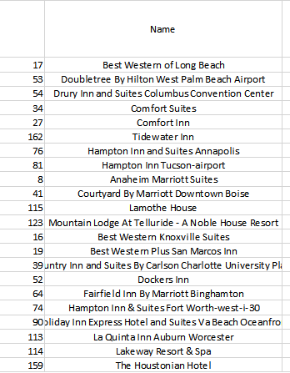
Methodology | Recommendations
Approaches comparison
© Chaitanya Mohite | Ahmed Mohamed
Ahmed Mohamed | Mohit Pradeep Hinduja | Indra Sardesai
Notes:
18

Slide 19
Limitations & Future results
Data translated using google translate
R library for different languages cleaning
Reviews dates were neglected
Including dates in our analysis, by having more recent reviews indicating better rating score
Review titles were neglected
Including the titles in our sentiment analysis to contribute to our hotel ratings
Classification of reviews according to location, staff, room, price & cleanliness
Having for each hotel reviews divided for the sub categories which contribute to the overall rating of the hotel
© Chaitanya Mohite | Ahmed Mohamed
Ahmed Mohamed | Mohit Pradeep Hinduja | Indra Sardesai
Notes:
19

Slide 20
Thank you!
© Chaitanya Mohite | Ahmed Mohamed
Ahmed Mohamed | Mohit Pradeep Hinduja | Indra Sardesai
Notes:
20

